Slide 1
Welcome to the Monthly KESA Updates and Support Meeting!
This session is scheduled to start promptly at 9:00 a.m.

Slide 2
Kansas Education System Accreditation (KESA) Update – November 9, 2021
Notes:
Welcome everyone to the KESA Update for February. I am glad to see and be able to visit with you today. (next slide)

Slide 3
Today’s Purpose
Reminders about the KESA Application
Regional Training and Support Model
General Updates
Definitions of accreditation
Answer any of your questions

Slide 4
KESA Application
Notes:
Still accessed through the Authenticated Application

Slide 5
KESA Application: Things to know
Reports are not lost
Current, Past, Archived
All systems years two – five need to use the add new goal button to place their goals in the KESA Application
Perfect time to make sure you have goals that are measurable and written in such a manner.
Goals statements are to be placed in System Yearly Update – Year One (last box once you open the goal dropdown…look for measurable goal question).
Notes:
Perfect opportunity to be provide clear and specific goals if not available.
If you have been following a true improvement process you should know where to find your goals.
If Year Five system - Look at System Yearly Update – Year Three past reports for goal areas and priorities
If Year Four System – Look at System Yearly Update - Year Two

Slide 6
KESA Application: Things to know
Compliance – will be done by KSDE
Compliance issues found in this section must speak about progress to be in full compliance.
Be sure to mark N/A in areas where you have no answer
Save often
Artifacts found in System Response section
Systems were asked to place their Pause Survey here
Steamlined

Slide 7
Regional Training and Support Model
Purposeful Support for systems in the beginning of their accreditation cycle (Year One)
Training around continuous improvement phases
Data Analysis
Set Goals
Strategy Selection
Strategy Implementation
Strategy Analysis
This Year three service centers participating with the others joining next year
Notes:
Data Analysis (2 days) 2nd day in Sublette on the 11th, then Greenbush, then Orion
Set Goals (1 – 2 days) Currently being developed
Strategy Selection (1)
Strategy Implementation (1)
Strategy Analysis (1)

Slide 8
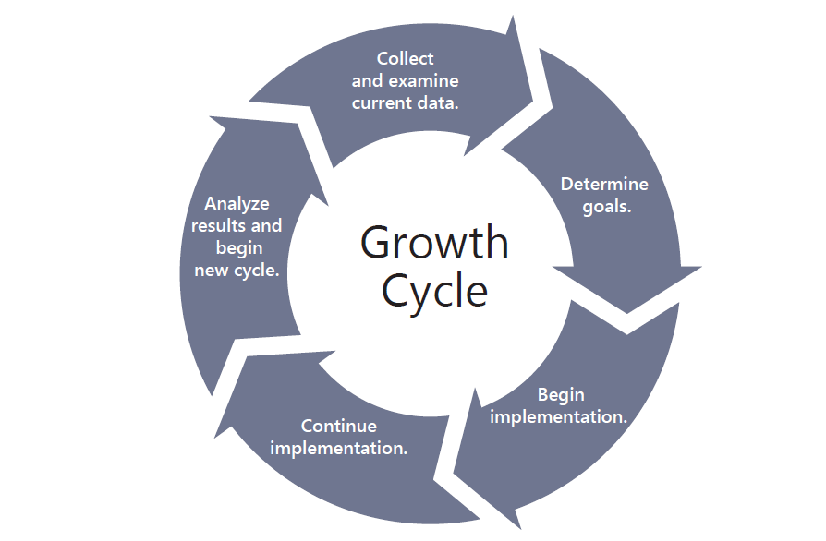
Data Analysis
Strategy Analysis
Set Goals
Strategy Implementation
Strategy Selection

Slide 9
Data
Analysis
Set Goals
Strategy Selection
Strategy Analysis
Strategy Implementation

Slide 10
Regional Training and Support Model
This Year three service centers participating with the others joining next year
Training for other sections in development
Topics for each phase (next slide)
Notes:
Data Analysis (2 days) 2nd day in Sublette on the 11th, then Greenbush, then Orion
Set Goals (1 – 2 days) Currently being developed
Strategy Selection (1)
Strategy Implementation (1)
Strategy Analysis (1)

Slide 11
Data Analysis | Set Goals | Strategy Selection | Strategy Implementation | Strategy Analysis
-Identify and analyze data sources, both qualitative & quantitative -Prioritize and compare data: perception vs. reality -Analyze prioritized data points | -Clarify core values and vision -Set and align goals with data -Move State Board Outcomes & Definition of Successful High School Graduate -Involve and engage family, community, and business | -Select measurable strategies -Select evidence-based strategies -Strategies support your goals | -Create an implementation plan -Support with professional development -Execute and sustain with fidelity | -Evaluate -Monitor -Adjust

Slide 12
General Updates
Accreditation Advisory Council
Accreditation Review Council
Newsletter
Guidance Document
OVT Online Training

Slide 13
Accreditation Definitions
“Accredited” means the system is in good standing (compliance) with the State Board, and that they have provided conclusive evidence of growth in student performance. In addition, the system has provided conclusive evidence of an intentional, quality growth process.

Slide 14
Accreditation Definitions
“Conditionally Accredited” means the system is in good standing (compliance) with the State Board, and either the system did not provide conclusive evidence of growth in student performance or was not able to provide conclusive evidence of an intentional, quality growth process.

Slide 15
Accreditation Definitions
“Not Accredited” means one of two things:
The system is not in good standing (compliance) with the State Board; or
The system did not provide conclusive evidence of growth in student performance, and the system was not able to provide conclusive evidence of an intentional, quality growth process.

Slide 16
2021-2022 Monthly KESA Updates
Tuesday, October 12, 2021
Tuesday, November 9, 2021
Tuesday, December 14, 2021
Tuesday, January 11, 2022
Tuesday, February 8, 2022
Tuesday, March 8, 2022
All KESA monthly updates are done via Zoom and recorded. They are scheduled from 9:00 – 10:00 a.m. on the dates listed above.
Registration: https://ksde.zoom.us/meeting/register/tZMpfu6prDgqG9NdArF0ovR2otXJyBq0U_Oe
Notes:
Please mark your calendars for next year’s KESA Updates. A reminder with the dates, time and zoom link for registration will be sent out in August.

Slide 17
Questions?

Slide 18
Thank You!

Slide 19
Dr. Mischel D. Miller Director Teacher Licensure and Accreditation (785) 296-8010 mmiller@ksde.org
Jeannette Nobo
Assistant Director- KESA Teacher Licensure and Accreditation (785) 296-4948 jnobo@ksde.org
Myron Melton
KESA Coordinator
Teacher Licensure and Accreditation
(785) 296-8110
mmelton@ksde.org
John Girodat
Education Program Consultant - KESA
Teacher Licensure and Accreditation
(785) 368-7356
jgirodat@ksde.org
Ed Kalas, Education Program consultant
Professional Learning and Mentoring
Teacher Licensure and Accreditation
(785) 296-2198
ekalas@ksde.org

